Slide 1
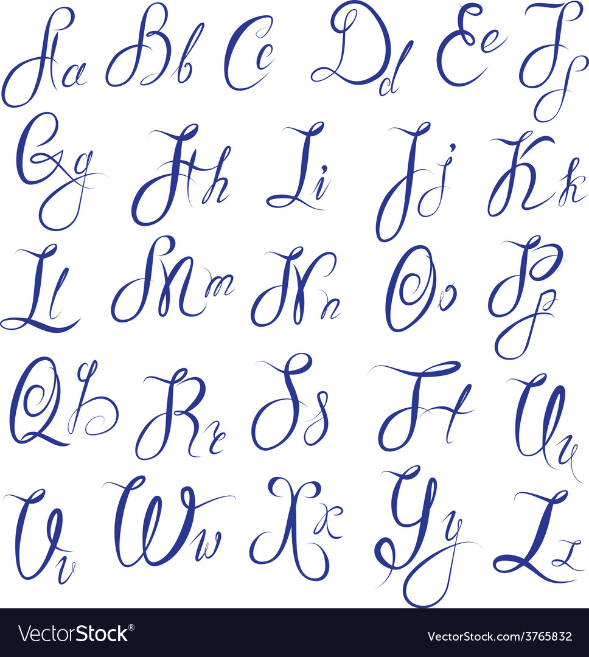
Learning from images project: Recognition of handwritten letters
Malo Hangran
Simon Molz

Slide 2
Table of contents
01
Introduction
02
Image preprocessing
03
Machine learning architectures
04
Model application

Slide 3
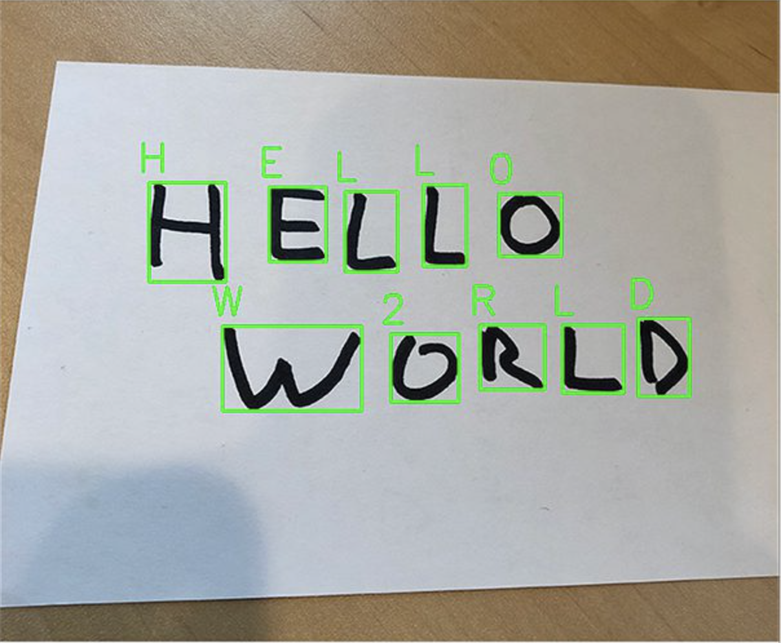
Objective of the project

Slide 4
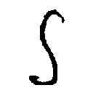
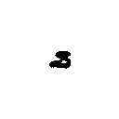
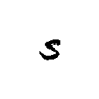
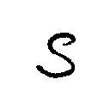
Data set used
370000+ English Alphabets Image Data-set
https://www.kaggle.com/datasets/sachinpatel21/az-handwritten-alphabets-in-csv-format

Slide 5
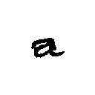

Image preprocessing (1/2)
28x28px
28x28px
Eliminate outer
blank
Inserting it into a 28x28 white image
Invert the
color

Slide 6
Image preprocessing (2/2)
Label vector
Value vector
a
a
a
b
b
…
255 | 232 | …
0 | 20 | …
230 | 180 | …
10 | 255 | …
130 | 132 | …
255 | 240 | …
372000 letters
28x28=784

Slide 7



Algorithm structure
Train
Test
Validation

Slide 8
Neural network parameters
Number of epochs -> 20
Train size -> 60% of the whole dataset
Validation size -> 20% of the whole dataset
Test size -> 20% of the whole dataset
Learning rate -> varying between 0.01 and 0.0001
Momentum -> 0.9
Batch size -> 0.1
Loss -> CrossEntropyLoss
Optimizer -> SGD optimizer from pytorch

Slide 9
Neuronal network architecture
Model 1
Learning rate -> 0.001
2048
2048
26
linear
linear
linear
…
Flatten
…
ReLU
…
ReLU
…
Softmax
26
28x28
dropout = 0.5

Slide 10
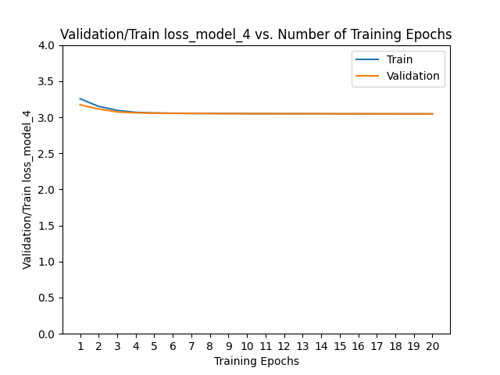
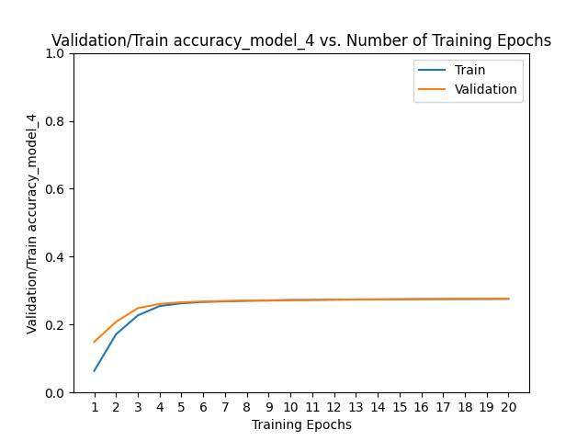
Neuronal network architecture
Model 1 - Results

Slide 11
Neuronal network architecture
Model 2
Learning rate -> 0.0001
64
128
512
28x28x1
32
26
conv2d
conv2d
linear
linear
conv2d
…
…
…
…
1152
…
…
: MaxPool2d
: Flatten
: Dropout=0.2
: ReLU

Slide 12
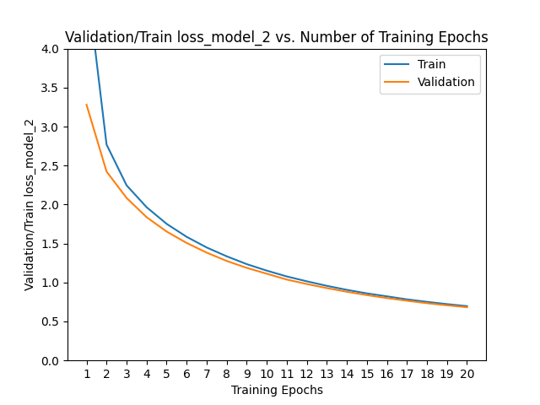
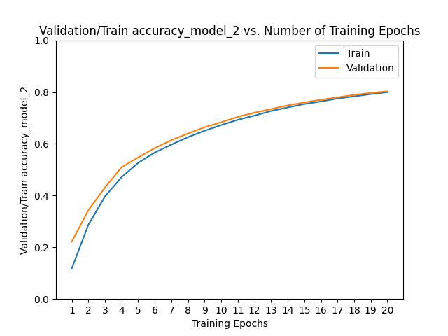
Neuronal network architecture
Model 2 - Results
Notes:
Ajouter : on aurait pu aller à 30 mais celui là prend du temps à entraîner

Slide 13
Neuronal network architecture
Model 3
Learning rate -> 0.001
Max
Pool2d
conv2d
conv2d
conv2d
conv2d
28x28x3
32
ReLU
32
ReLU
64
ReLU
64
ReLU
Max
Pool2d
Max
Pool2d
Flatten
conv2d
linear
Dropout
conv2d
128
ReLU
128
ReLU
2048
1024
ReLU
0.25
linear
Dropout
linear
1024
ReLU
0.5
32
Softmax

Slide 14
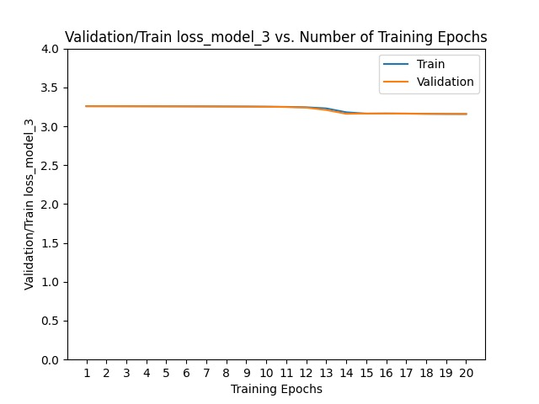
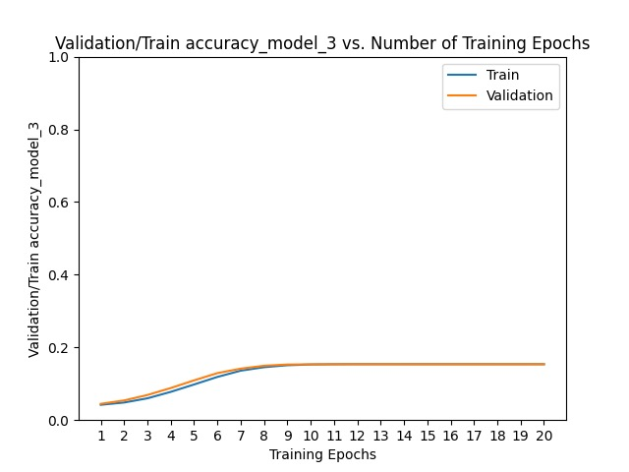
Neuronal network architecture
Model 3 - Results

Slide 15
Neuronal network architecture
Model 4
Learning rate -> 0.01
Max
Pool2d
Batchnorm
Batchnorm
Max
Pool2d
Batchnorm
conv2d
conv2d
conv2d
28x28x1
32
64
64
Batchnorm
Max
Pool2d
Batchnorm
conv2d
conv2d
Batchnorm
conv2d
conv2d
128
128
256
256
Flatten
Linear output
linear
Dropout
256
256
ReLU
0.2
26

Slide 16
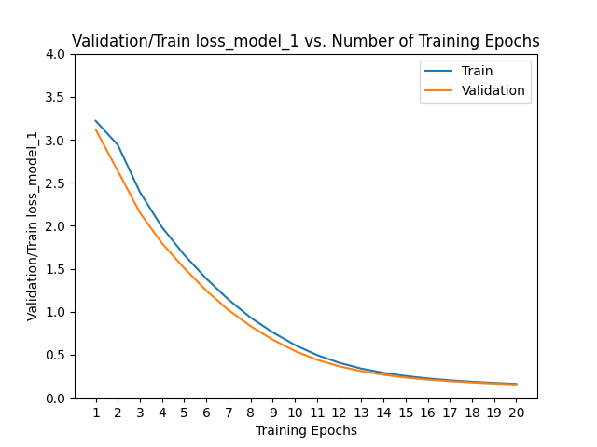
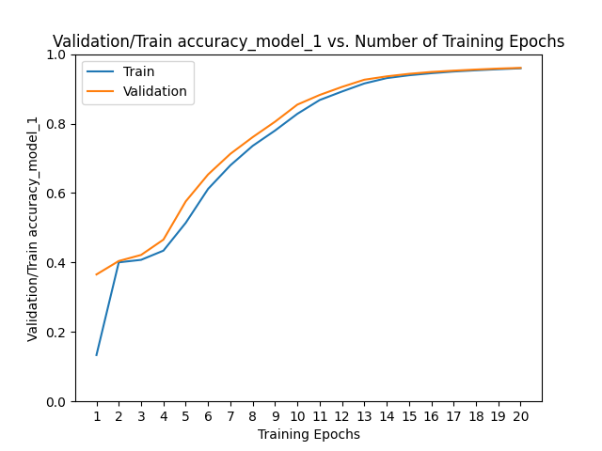
Neuronal network architecture
Model 4 - Results

Slide 17
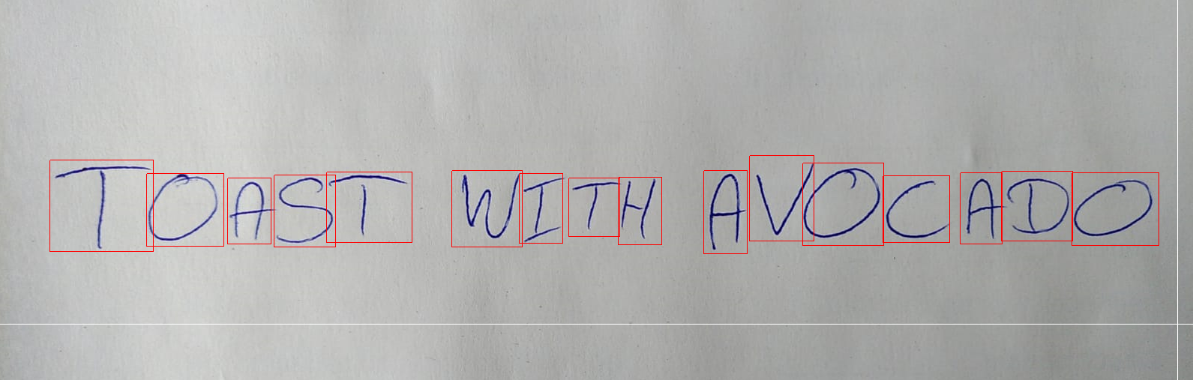
Model application (model 4)

Slide 18
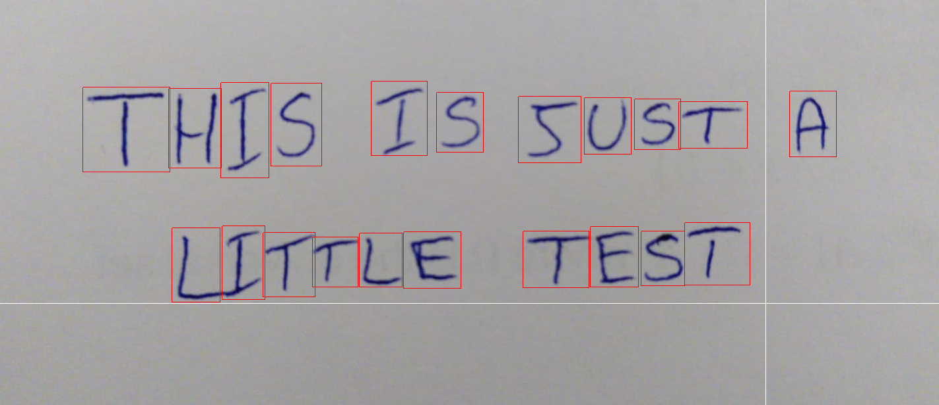
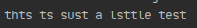
Model application (model 1)

Slide 19
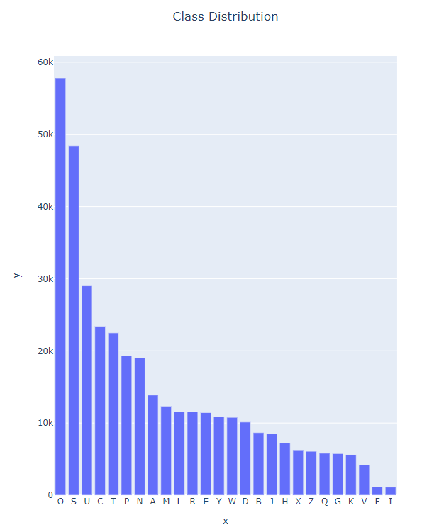
Train data distribution

Slide 20
Ways to improve
Changing data set
Cuda
Different models

Slide 21
Thank you for your attention!
Do you have any questions?

Slide 22
Bibliography
Data set:
https://www.kaggle.com/datasets/sachinpatel21/az-handwritten-alphabets-in-csv-format
Architectures
https://www.kaggle.com/code/utkarshsaxenadn/a-z-alphabet-recognition-custom-model-acc-99/notebook
http://dspace.univ-tlemcen.dz/bitstream/112/12235/1/Classification-des-images-avec-les-reseaux-de-neurones.pdf
http://dspace.univ-tlemcen.dz/bitstream/112/12235/1/Classification-des-images-avec-les-reseaux-de-neurones.pdf
https://datacorner.fr/image-processing-7/

